Slide 1



Exploratory Data Analysis (EDA) for Real Estate Pricing
By Latha Payani

Slide 2

EDA Techniques for Real Estate Pricing
5. Feature Engineering
Create new features to enhance the model for price prediction
6. Size Impact Analysis
Investigate the effects of size-related features on the pricing
2.Cleaning Data Handle missing values, finding and filtering duplicates, trimming anomalies and Standardizing format
7. Market Trends
Analysis historical prices trends and their influences overtime.
3. Uni Variant Analysis Analyze single to understand their individual Distribution
8. Customer Preferences
Examine how amenities impact pricing based on customer preferences
4,. Bi & Multi Variant Analysis Explore relationships among multiple variables affecting house prices and calculating correlations
1. Loading Data Imported real estate data into a pandas data Frame to Analysis

Slide 3






Data Cleaning and Preparation
Loading data
Loaded housing data into a pandas Data Frame
Handling Missing Values
Identified and removed missing values by use of median and mode.
Standardize
Normalized text fields, Standardize measurement units.
Removed Duplicate Values
By Using dropna() I have removed duplicates in data
Data Validation
Implement checks to ensure data meets quality standards before analysis.
Outliers
Used IQR (Inter Quartile Range) method to Handled outliers

Slide 4
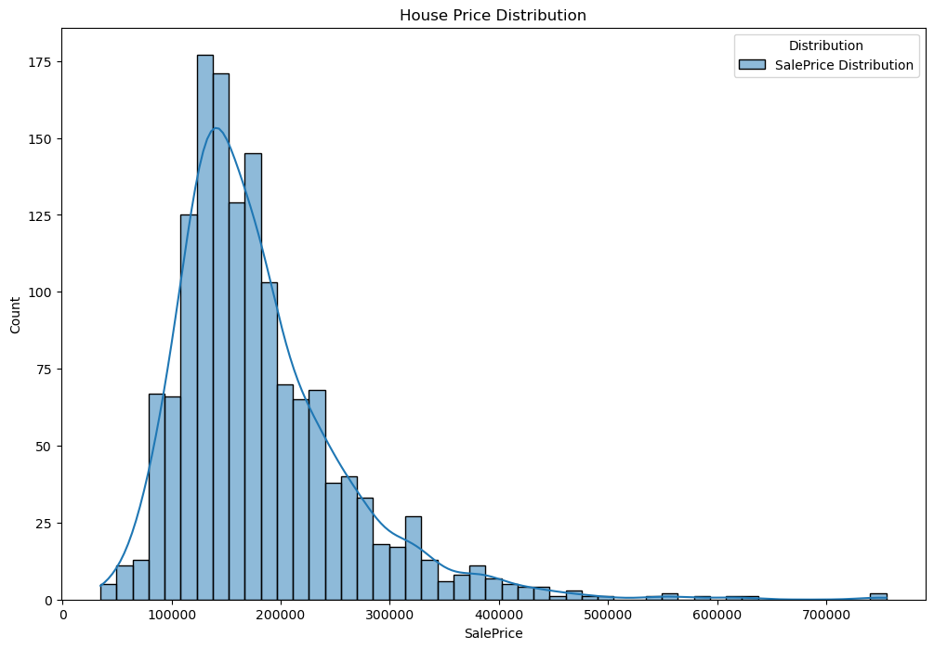



Uni-Variant Analysis
Uni-variant is a examines a single variable in a data set
Examine the Distribution and Characteristics of Individual features
Analyze the frequency and range of values
. Identify outliers and unusual patterns

Slide 5
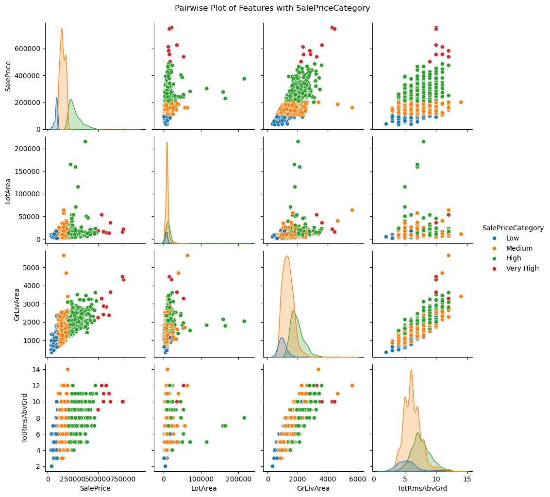
BI Variant Analysis
Bivariate analysis is one of the statistical analysis where two variables are observed. One variable here is dependent while the other is independent.
1
Visualized relationships using Pair plot, scatter plots, kernel plots, and other visualizations.
Explored Relationship between Variables

Slide 6
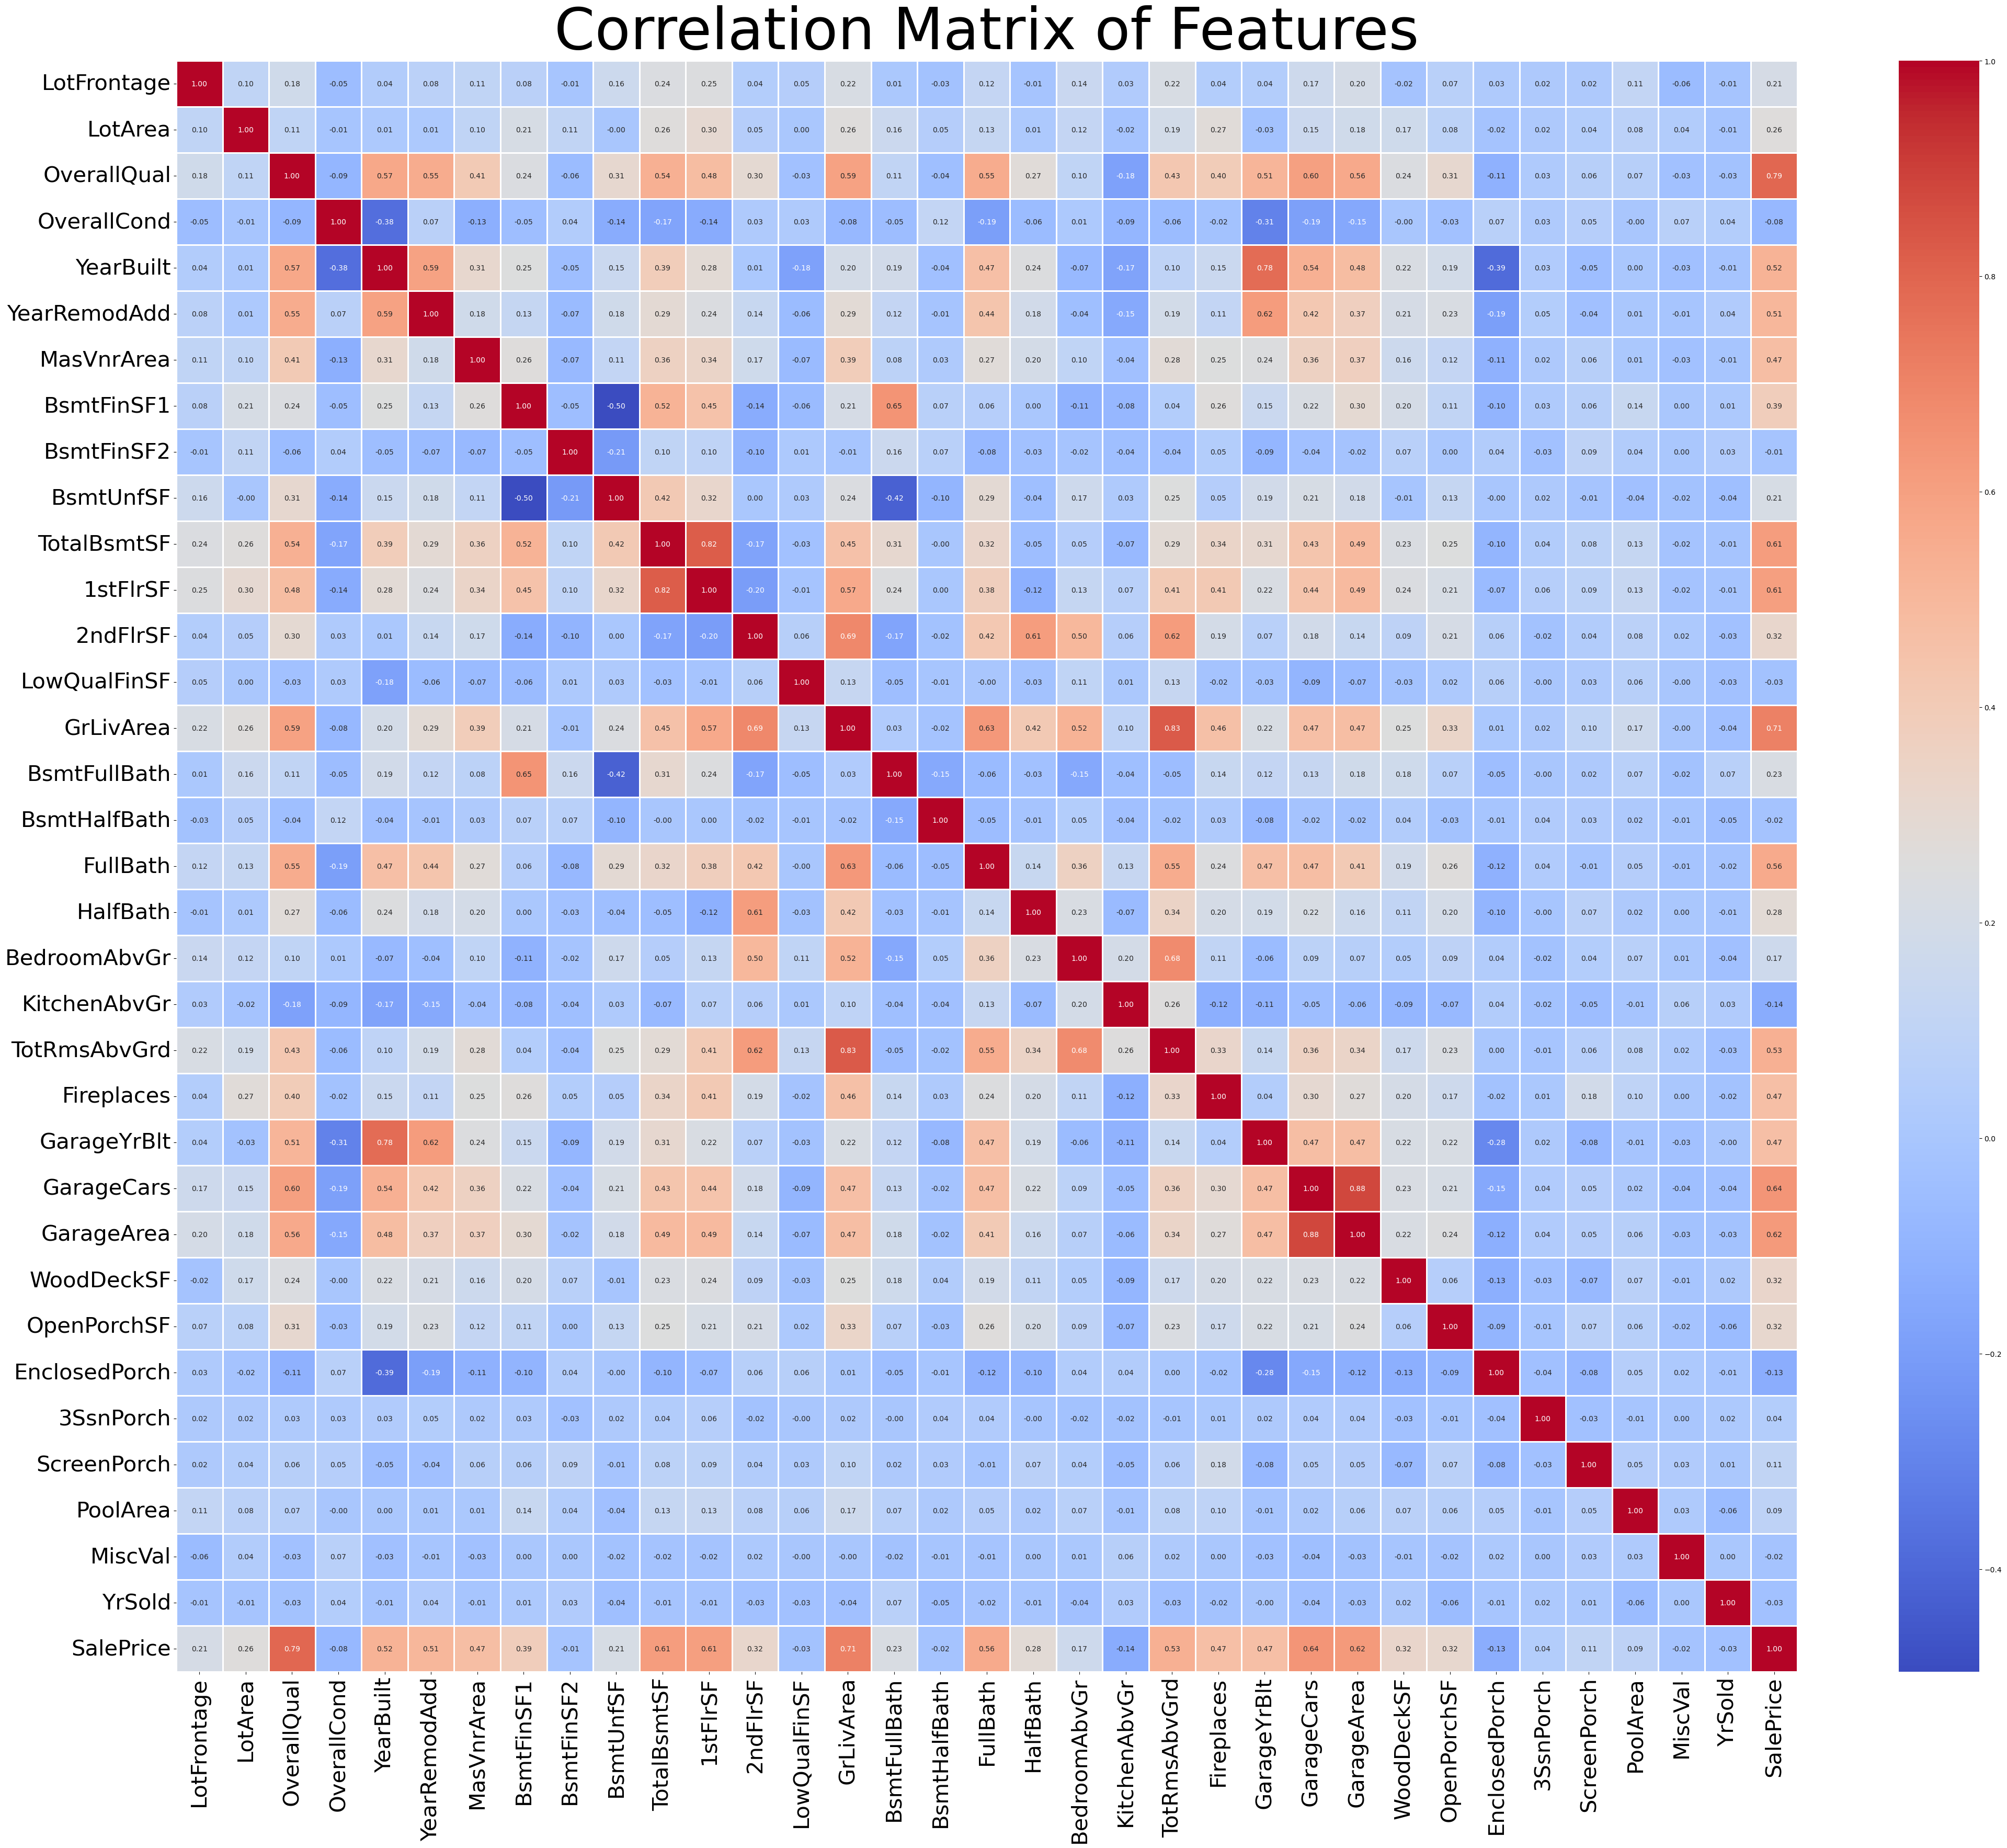

Slide 7
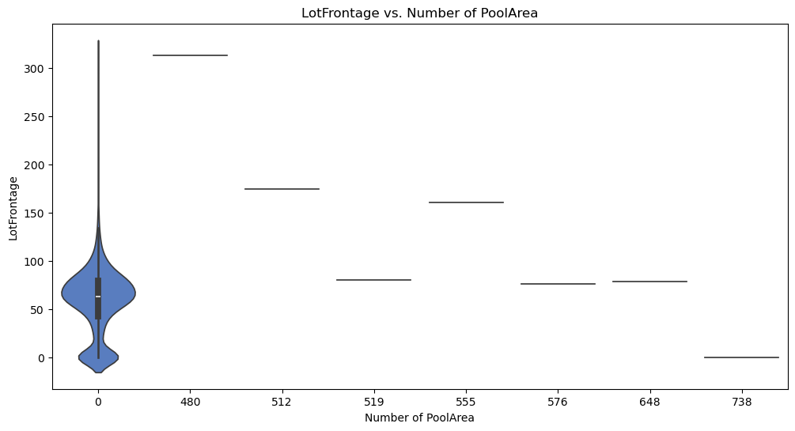
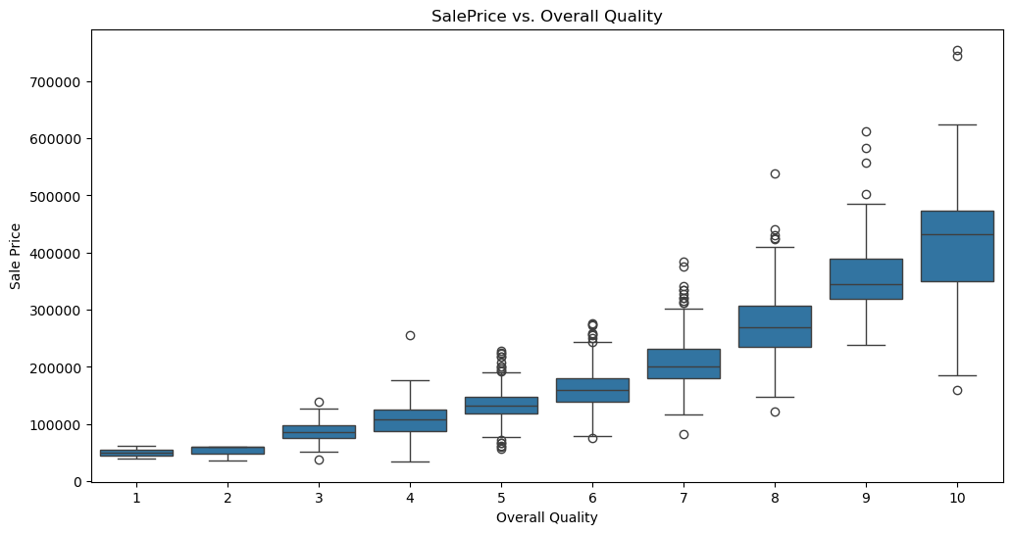
Multi Variant Analysis
statistical technique that analyses multiple variables at once
Applied techniques like multiple regression, principal component analysis, and cluster analysis.
Identify complex interactions and patterns

Slide 8
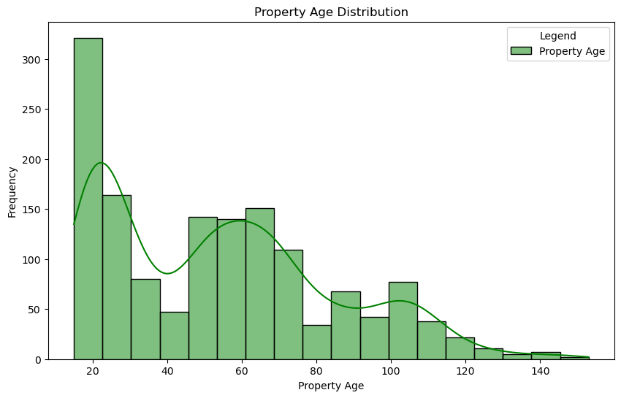
Feature Engineering
Feature Engineering is a process that prepares raw data for machine learning models by creating, selecting, and transforming relevant features.
Price for square feet ---- Calculated the price based on square footage.

Slide 9
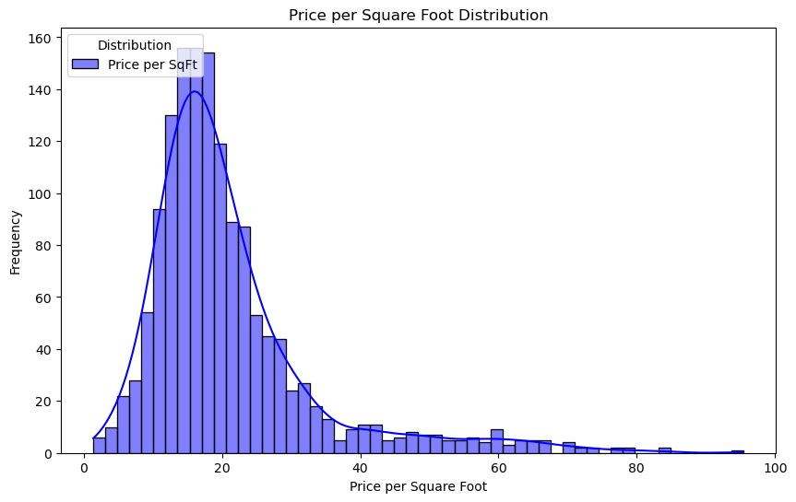
Property age Feature ---- property age to predict price Depreciation trends.

Slide 10
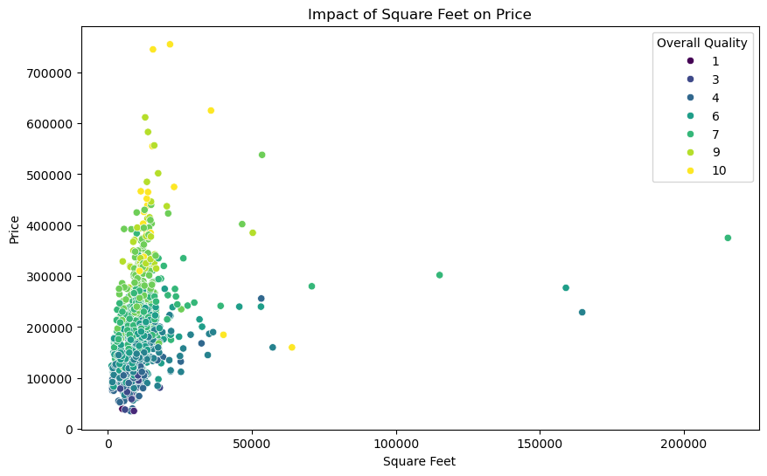
Feature Engineering and Size Impact

Slide 11
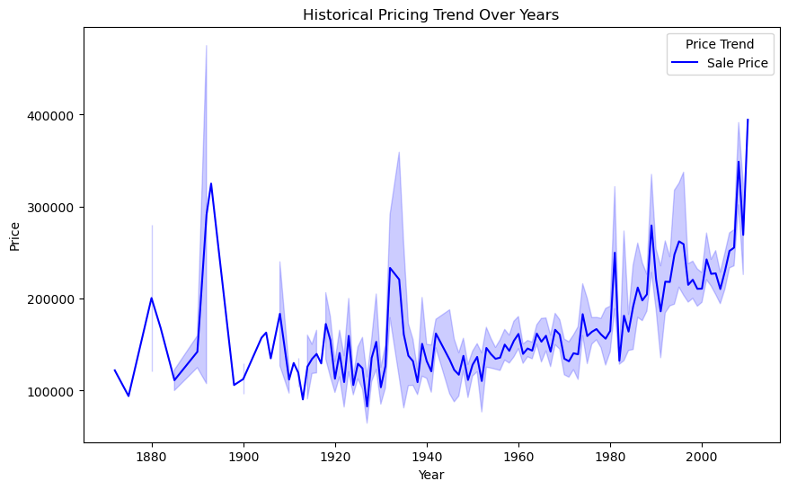
Market Trends and Historical Pricing
Price Surge
Significant Increase in home Values Observed
New Developments
Introduction of new housing projects boosts supply
Depreciation
Increase in mortgage rates impact buyer affordability
2019
2021
2023

Slide 12
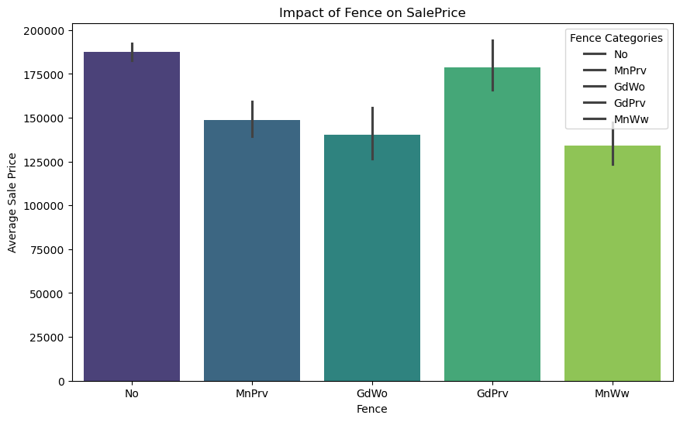
Customer Preferences and Amenities
Amenities
Features enhancing property value
Pool Area
Preferences aligning with prices
Fence
Amenities affecting market prices
Price
Market Value of property

Slide 13
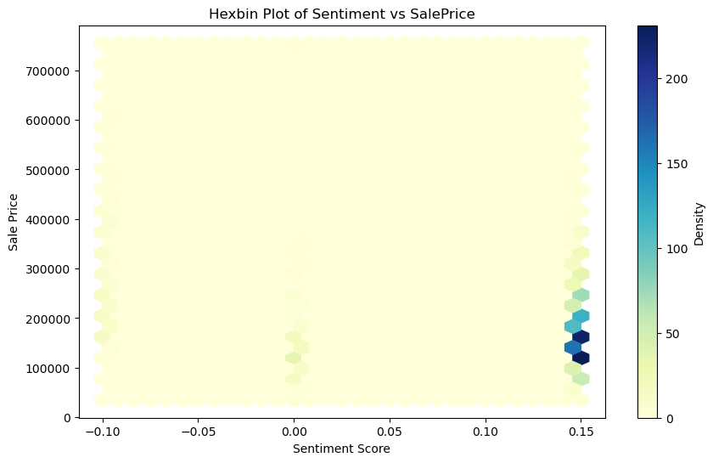

Sentiment Analysis
Customer Feedback
1
2
3
4
5

Slide 14
Challenges in Real Estate Data Analysis
Data Quality Market Dynamics
Ensure Consistent data Standards Analyze rapidly changing market trends
to avoid misleading conclusions during to capture true pricing influences.
analysis.
Feature Selection Missing Data
Identify relevant variables that Significantly impact Develop Strategies to handle missing values
house pricing accuracy in models. Without introducing bias in outcomes.
Customer Preferences
Incorporate Subjective buyer preferences to
to capture true market values expectations.

Slide 15
Thank you

